Slide 1
CS 540 Computer Networks II
Sandy Wang
chwang_98@yahoo.com
Notes:
“Data and Computer Communications”, 10/e, by William Stallings, Chapter 11 “Local Area Network Overview”.

Slide 2
6. Routing Protocols – ISIS
Notes:
In this chapter, we look at the underlying technology and protocol architecture
of LANs. Chapters 12 and 13 are devoted to a discussion of specific
LAN systems.

Slide 3
Topics
Overview
LAN Switching
IPv4
IPv6
Tunnels
Routing Protocols -- RIP, RIPng, OSPF
Routing Protocols -- ISIS, BGP
Midterm Exam
MPLS
Transport Layer -- TCP/UDP
Congestion Control & Quality of Service (QoS)
Access Control List (ACL)
Application Layer Protocols
Application Layer Protocols continue
Final Exam

Slide 4
Reference Books
Cisco CCNA Routing and Switching ICND2 200-101 Official Cert Guide, Academic Edition by Wendel Odom -- July 10, 2013. ISBN-13: 978-1587144882
The TCP/IP Guide: A Comprehensive, Illustrated Internet Protocols Reference by Charles M. Kozierok – October 1, 2005. ISBN-13: 978-1593270476
Data and Computer Communications (10th Edition) (William Stallings Books on Computer and Data Communications) by Williams Stallings – September 23, 2013. ISBN-13: 978-0133506488
http://class.svuca.edu/~sandy/class/CS540/

Slide 5
Interior and Exterior Gateway Protocols
 | Interior Gateway Protocols |  |  |  | Exterior Gateway Protocols
 | Distance Vector Routing Protocols |  | Link State Routing Protocols |  | Path Vector
Classful | RIPv1 (1982/1988) | IGRP (1985) |  |  | EGP (1982)
Classless | RIPv2 (1994) | EIGRP (1992) | OSPFv2 (1991) | IS-IS (1990) | BGPv4 (1995)
IPv6 | RIPng (1997) | EIGRP for IPv6 (not yet released) | OSPFv3 (1999) | IS-IS for IPv6 (2000) | BGPv4 for IPv6 (1999)
Note: IGRP and EIGRP are Cisco proprietary protocols. They are meant as an alternative between the limited RIP routing protocol and the more complicated and resource intensive OSPF and IS-IS routing protocols. IGRP was discontinued with IOS 12.2 in 2005.
The dates shown are when the RFC or other document was finalized. The protocol may have been implemented earlier than this date.

Slide 6
History
IS-IS: Intermediate System to Intermediate System
Described in ISO 10589, 1992
First production developed by Digital Equipment Corporation
Integrated IS-IS was proposed RFC 1195. Routing both ISO’s Connectionless-Mode Network Service (CLNS) and IP.

Slide 7
Similarities between OSPF & IS-IS
Link-state routing protocol and use a Dijkstra-based SPF algorithm to calculate shortest-path tree
Hellos to maintain adjacencies
Hierarchical
Provide address summarization
Classless
Elect Designated Router for broadcast networks
Authentication Capabilities

Slide 8
IS-IS versus OSPF - Terminology
IS-IS | OSPF | Comments
ES (End System) | Host
IS (Intermediate System) | Router
Circuit | Link
SNPA (Subnetwork Point of Attachment) | Datalink Address
PDU (Protocol Data Unit) | Packet
DIS (Designated Intermediate System) | DR (Designated Router)
N/A | BDR
IIH (IS-to-IS Hello Packet) | Hello packet

Slide 9
IS-IS versus OSPF - Terminology
IS-IS | OSPF | Comments
LSP (Link-State Packet) | LSA (Link -State Advertisement) | LSAs are actually comparable to TLVs used in LSPs.
CSNP (Complete Sequence Number PDU or Packet) | DBD (Data Base Description Packet)
PSNP (Partial Sequence Number PDU or Packet) | LSAck or LSR (Link State Request)
Routing Domain | AS | The term routing domain is also used with OSPF.
Level 1 Area | Area (non-backbone)
Level 2 Area | Backbone area (Area 0) | IS-IS uses a backbone path connected by contiguous L2 routers. There is no backbone area in IS-IS

Slide 10
IS-IS versus OSPF – ISs (Routers)
IS-IS | OSPF | Comments
Level 1 IS (router) | Internal Non-backbone Router | Internal, non-backbone router in a Totally Stubby Area
Level 2 IS (router) | Internal Backbone Router or ASBR | Any Level 2 router can distribute externals into the domain. No special name. (Cisco IOS allows Level 1 routers to distribute externals.)
Level 1-2 IS (router) | ABR
System ID | Router ID | The System ID is the key for SPF calculations. Sometimes the NET address is thought of as the Router ID.
AFI = 49 | RFC 1918 Addresses | AFI is part of the NSAP.

Slide 11
IS-IS versus OSPF - Timers
Interface | IS-IS | OSPF
Point-to-Point | Hello – 10 sec Holdtime – 30 sec | Hello – 10 sec Dead – 40 sec
Broadcast | Hello – 10 sec Holdtime – 30 sec | Hello – 10 sec Dead – 40 sec
NBMA | N/A | Hello – 30 sec Dead – 120 sec
Other | IS-IS | OSPF
LS Aging | 1,200 sec or 20 min (counts down) | 3,600 sec or 60 min (counts up)
LS Refresh | Every 15 min | Every 30 min
NBMA | N/A | Hello – 30 sec Dead – 120 sec
SPF Delay/Holdtime | 5.5 sec / 10 sec | 5 sec / 10 sec

Slide 12
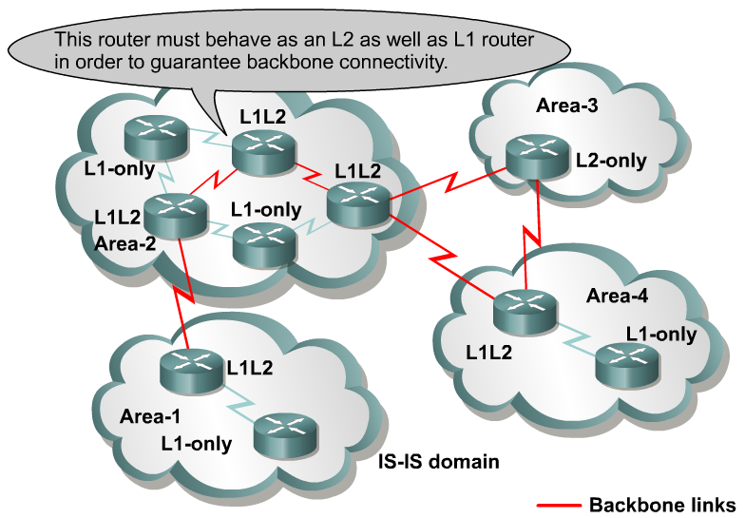
Level 1 Router
Level 1 IS (L1 IS, router)
Analogous to OSPF Internal non-backbone router (Totally Stubby)
Responsible for only routing to ESs inside an area.
Level 1 routers maintain the Level 1 database for the area and exit points to neighboring areas.
Notes:
Level 1 IS (L1 IS, router)
Analogous to OSPF Internal non-backbone router (Totally Stubby)
Responsible for routing to ESs inside an area.
A contiguous group of Level 1 routers define an area.
Level 1 routers maintain the Level 1 database for the area and exit points to neighboring areas.

Slide 13
Level 2 Router
Level 2 IS (L2 IS, router)
Analogous to OSPF Internal Backbone router
Responsible for routing between areas
Also referred to as area routers.
Interconnects the Level 1 areas
Store separate database of only inter-area topology
Notes:
Level 2 IS (L2 IS, router)
Analogous to OSPF Internal Backbone router
Responsible for routing between areas
Also referred to as area routers.
Interconnect the Level 1 areas
Store separate database of only inter-area topology
All interfaces in the same area

Slide 14
Level 1 – Level 2 Router
Level 1 and Level 2 IS (L1-L2 IS, router)
Analogous to OSPF ABR router
Participate in both L1 intra-area routing and L2 inter-area routing.
Maintain both Level 1 and Level 2 LSDB
Support Level 1 function communicating with other Level 1 routers in their area
Inform other Level 1 routers that they are the exit point (default route) from the area.
Support Level 2 function communicating with the rest of the backbone path.
Notes:
Level 1 and Level 2 IS (L1-L2 IS, router)
Analogous to OSPF ABR router
Participate in both L1 intra-area routing and L2 inter-area routing.
Maintain both Level and Level 2 LSDB
Support Level 1 function communicating with other Level 1 routers in their area
Inform other Level 1 routers that they are the exit point (default route) from the area.
Support Level 2 function communicating with the rest of the backbone path.
All interfaces in the same area

Slide 15
IS-IS Backbone
IS-IS does not share the concept of a backbone area 0 with OSPF.
IS-IS backbone a set of distinct areas interconnected by a chain of Level 2 routers, weaving their way through and between the Level 1 Areas.
The IS-IS backbone (path) consists of a contiguous set of Level 1-2 and Level 2 routers.
Where is the backbone (path)?
Notes:
IS-IS does not share the concept of a backbone area 0 with OSPF.
An IS-IS backbone can appear as a set of distinct areas interconnected by a chain of Level 2 routers, weaving their way through and between the Level 1 Areas.
The IS-IS backbone (path) consists of a contiguous set of Level 1-2 and Level 2 routers.
Where is the backbone (path)?

Slide 16
ISO Addressing
NSAP (Area, System ID, NSEL)
SNAP

Slide 17
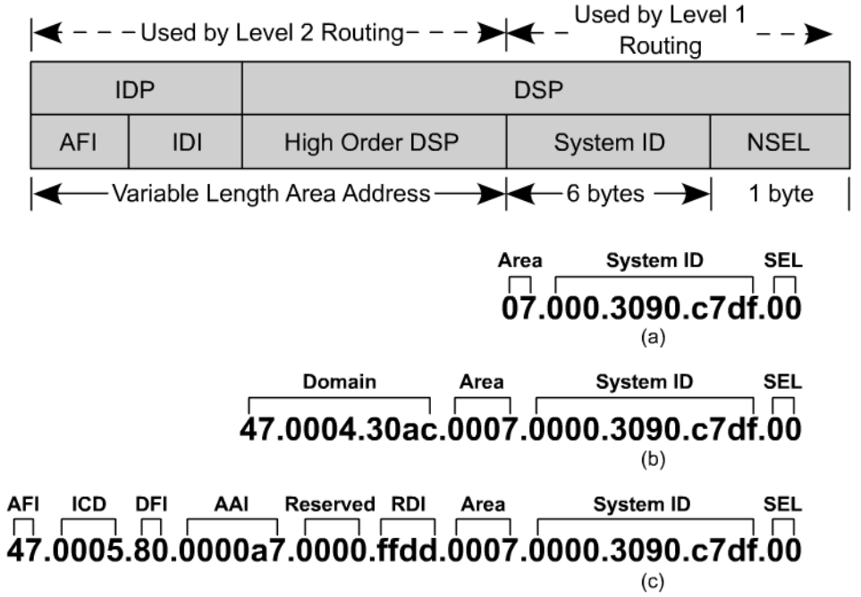
ISO Address
NSAP
IS-IS uses OSI network layer addressing: 8 to 20 bytes
Network Entity Title (NET) Described in ISO 8348
A variety of NSAP formats exist, which we will not go into.
Represented in hexadecimal (up to 40 hex digits)
Cisco format: Area – System ID – NSEL (always 00 on ISs)
49.0001.2222.2222.2222.00
Notes:
OSI network layer addressing is done through the NSAP (Network Service Access Point) consisting of:
OSI Address of the device
OSI network services provided to the transport layer
Conceptual boundary between network and transport layers
A variety of NSAP formats exist, which we will not go into.
Represented in hexadecimal (up to 40 hex digits)
Cisco format: Area – System ID – NSEL (always 00 on ISs)
49.0001.2222.2222.2222.00

Slide 18
OSI Addressing
NSAP
(a) Simple Area ID/System ID Format
(b) An OSI NSAP Format
(c) a GOSIP NSAP Format (Government Open System Interconnection Profile)
AFI – Authority and Format identifier
ICD – International Code Designator
DFI – Domain Specific Part (DSP) Format identifier
AAI – Administrative Authority identifier
RDI – Routing Domain Identifier (Autonomous system number)
SEL: Network Service Access Point (NSAP) Selector
Notes:
OSI network layer addressing is done through the NSAP (Network Service Access Point) consisting of:
OSI Address of the device
OSI network services provided to the transport layer
Conceptual boundary between network and transport layers
A variety of NSAP formats exist, which we will not go into.
Represented in hexadecimal (up to 40 hex digits)
Cisco format: Area – System ID – NSEL (always 00 on ISs)
49.0001.2222.2222.2222.00

Slide 19
OSI Addressing
NSAP
Must begin with single octet (47.xxxx….)
Must end with single octet
Notes:
OSI network layer addressing is done through the NSAP (Network Service Access Point) consisting of:
OSI Address of the device
OSI network services provided to the transport layer
Conceptual boundary between network and transport layers
A variety of NSAP formats exist, which we will not go into.
Represented in hexadecimal (up to 40 hex digits)
Cisco format: Area – System ID – NSEL (always 00 on ISs)
49.0001.2222.2222.2222.00

Slide 20
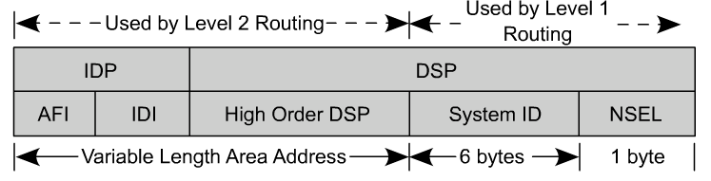
NSAPs
Format of the Cisco NSAP address consists of three parts.
Area address
System ID
NSAP selector byte
Area address is a variable length field
The system ID is the ES or IS identifier in an area, similar to the OSPF router ID.
The system ID has a fixed length of six bytes as engineered in the Cisco IOS.
The NSAP selector byte is a service identifier.
Analogous to that of a port or socket in TCP/IP.
Notes:
Format of the Cisco NSAP address consists of three parts.
Area address
System ID
NSAP selector byte
Area address is a variable length field
The system ID is the ES or IS identifier in an area, similar to the OSPF router ID.
The system ID has a fixed length of six bytes as engineered in the Cisco IOS.
The NSAP selector byte is a service identifier.
Analogous to that of a port or socket in TCP/IP.

Slide 21
NSAPs – Cisco Format
Area – System ID – NSEL 49.0001.2222.2222.2222.00
Area
Addresses starting with 49 (AFI=49) are considered private IP address, analogous to RFC 1918.
Routed by IS-IS
Should not be advertised to other CLNS networks (outside this IS-IS domain)
Additional 2 bytes (0001) added for the area ID
All routers in the same are must have the same area address
Notes:
Area
Addresses starting with 49 (AFI=49) are considered private IP address, analogous to RFC 1918.
Routed by IS-IS
Should not be advertised to other CLNS networks (outside this IS-IS domain)
Additional 2 bytes (HODSP) added for the area ID
All routers in the same are must have the same area address

Slide 22
NSAPs – Cisco Format
Area – System ID – NSEL 49.0001.2222.2222.2222.00
System ID
Cisco fixes the System ID at 6 bytes.
Customary to use one of the following:
MAC address from the router
IP address of loopback interface
192.168.111.3 -> 192.168.111.003 -> 1921.6811.1003
Each device (IS and ES) must have a unique System ID within the area. (Recommended to make them unique within the domain.)
Notes:
System ID
OSI requires it must be the same number of bytes throughout the domain.
Cisco fixes the System ID at 6 bytes.
Customary to use one of the following:
MAC address from the router
IP address of loopback interface
192.168.111.3 -> 192.168.111.003 -> 1921.6811.1003
Each device (IS and ES) must have a unique System ID within the area. (Recommended to make them unique within the domain.)

Slide 23
NSAPs – Cisco Format
Area – System ID – NSEL 49.0001.2222.2222.2222.00
NSEL (NSAP Selector)
NSEL is a service identifier.
Loosely equivalent to that of a port or socket in TCP/IP.
Not used in routing decisions.
NET (Network Entity Title)
When NSEL = 00, it identifies the device itself, the network level address.
The NSAP with a NSEL = 00 is known as a Network Entity Title (NET)
A NET is an NSAP with the NSEL set to (00)
Notes:
NSEL (NSAP Selector)
NSEL is a service identifier.
Loosely equivalent to that of a port or socket in TCP/IP.
Must be specified by a single byte preceded by a period (.)
Not used in routing decisions.
NET
When NSEL = 00, it identifies the device itself, the network level address.
The NSAP with a NSEL = 00 is known as a Network Entity Title (NET)
A NET is an NSAP with the NSEL set to (00)

Slide 24
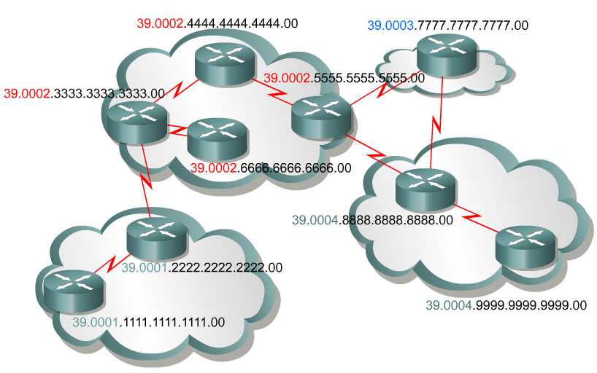
NSAP (NETs)
Area – System ID – NSEL 49.0001.2222.2222.2222.00
Other Examples
Example 1: NSAP 47.0001.aaaa.bbbb.cccc.00
Area ID is:
47.0001
System ID is:
aaaa.bbbb.cccc
NSAP selector byte is:
00
Example 2: NSAP 39.0f01.0002.0000.0c00.1111.00
Area ID is:
39.0f01.0002
System ID is:
0000.0c00.1111
NSAP selector byte is:
00
Notes:
Example 1: NSAP 47.0001.aaaa.bbbb.cccc.00
Area ID is 47.0001
System ID is aaaa.bbbb.cccc
NSAP selector byte is 00
Example 2: NSAP 39.0f01.0002.0000.0c00.1111.00
Area ID is 39.0f01.0002
System ID is 0000.0c00.1111
NSAP selector byte is 00

Slide 25
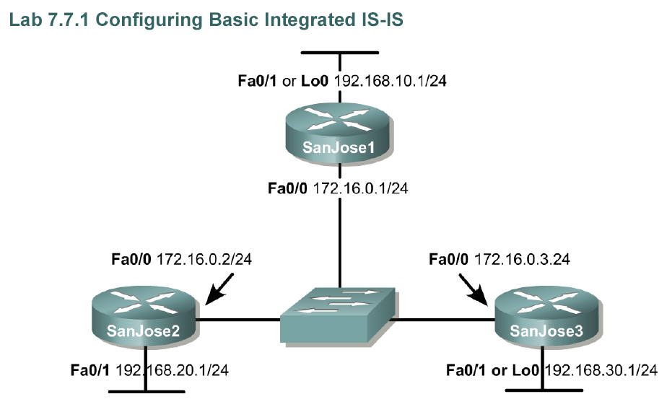
Configuring IS-IS (so far)
Area 49.0001
SanJose1
interface FastEthernet0/0
ip address 172.16.0.1 255.255.255.0
ip router isis
isis priority 100
router isis
net 49.0001.1111.1111.1111.00
SanJose2
interface FastEthernet0/0
ip address 172.16.0.2 255.255.255.0
ip router isis
router isis
net 49.0001.2222.2222.2222.00
Area . System ID . NSEL
SanJose3
interface FastEthernet0/0
ip address 172.16.0.3 255.255.255.0
ip router isis
router isis
net 49.0001.3333.3333.3333.00
ip router isis: IS-IS must be enabled on the interface
Note: IS-IS routing cannot be enabled on an interface until an IP address has been configured on the interface.
IOS: Cisco IOS 12.2(12) with Enterprise Plus (16 MB Flash/48 MB RAM) or Enter Plus IPSec56 (16 MB Flash/64 MB RAM)
Notes:
ip router isis: IS-IS must be enabled on the interface
IOS: Cisco IOS 12.2(12) with Enterprise Plus (16 MB Flash/48 MB RAM) or Enter Plus IPSec56 (16 MB Flash/64 MB RAM)
Note: IS-IS routing cannot be enabled on an interface until an IP address has been configured on the interface.

Slide 26
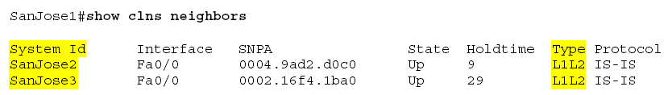
Configuring IS-IS (so far)
Area 49.0001
To display both ES and IS neighbors.
SNPA (Subnetwork Point of Attachment) address is the interface circuit ID.
Ethernet: MAC address of the remote router.
Serial, would show encapsulation, I.e. HDLC
Type: Cisco routers default to L1-L2 type routers.
We will see how to change this in a moment.
Notes:
To display both ES and IS neighbors.
SNPA is the MAC address of the remote router.
If serial, would show encapsulation, I.e. HDLC
Cisco routers default to L1-L2 type routers.
We will see how to change this in a moment.

Slide 27
Hello Messages
IS-IS uses Hello PDUs to establish adjacencies with other routers
L1-only routers and L1/L2 routers → L1 adjacency
L2-only routers and L1/L2 routers → L2 adjacency
L1-only and L2-only routers → No adjacency
Rules:
Two L1-only routers form an L1 adjacency only if their AIDs match
Two L2-only routers from an L2 adjacency, even if their AIDs are different
An L1-only router forms an L1 adjacency with an L1/L2 router only if their AIDs match
An L2-only router forms an L2 adjacency with an L1/L2 router even if their AIDs are different
Two L1/L2 routers form both L1 and L2 adjacencies if their AIDs match
Two L1/L2 routers form only and L2 adjacency if their AIDs do not match
Notes:
IS-IS uses Hello PDUs to establish adjacencies with other routers (ISs) and ESs.
IS-IS has three types of Hello PDUs:
ESH, sent by ES to an IS
ISH, sent by IS to an ES
IIH, used between two ISs (CCNP 1)
Hello Level 1 LAN
Hello Level 2 LAN
Hello Point-to-Point
In OSI there are only two main types of physical links:
Broadcast: Multiaccess media types, usually LANs
Nonbroadcast: Point-to-Point, Multipoint, and dynamically established links (WAN links)
Thus, IS-IS supports only two media representations:
Broadcast for LANs
Point-to-Point for all other media
IS-IS has no concept of an NBMA network.
Recommended that point-to-point links be used for native ATM, Frame Relay, or X.25

Slide 28
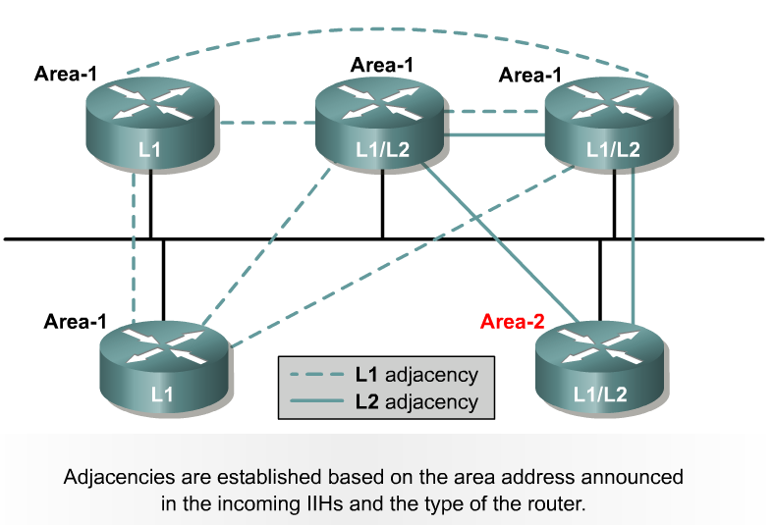
Adjacencies
LAN Adjacencies
L1 routers form L1 adjacencies with L1 and L1-L2 routers in their area.
L2 routers form L2 adjacencies with L2 and L1-L2 routers in their area or another area.
L1 router does not form an adjacency with an L2 router
Notes:
L1 routers form L1 adjacencies with L1 and L1-L2 routers in their area.
L2 routers form L2 adjacencies with L2 and L1-L2 routers in their area or another area.
L1L2 routers form L1 and L2 adjacencies with each other in their area or another area.
L1 router does not form an adjacency with an L2 router

Slide 29
Level 1 and Level 2 Adjacencies
L1/L2
L1
L1
L1/L2
L2
Level 1 Adjacencies
Level 2 Adjacencies
L1/L2
L1
L1/L2
L1
L1
L1/L2
L2
L1
L1/L2
L2

Slide 30
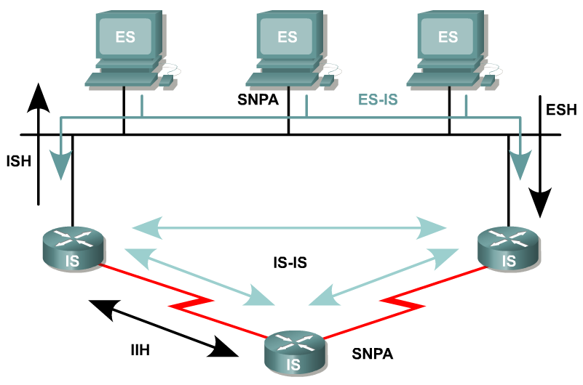
Neighbors and Adjacencies
IS-IS discover neighbors and forms adjacencies using IS-IS Hello PDUs.
Transmitted every 10 seconds
Can be changed using the interface command, is hello-interval
Hold time defaults to 3 times the Hello time (30 seconds), before declaring a neighbor dead.
Changed using the interface command is hello-multiplier
Default is 3
Notes:
IS-IS discover neighbors and forms adjacencies using IS-IS Hello PDUs.
Transmitted every 10 seconds
Can be changed using the interface command, is hello-interval
Hold time defaults to 3 times the Hello time (30 seconds), before declaring a neighbor dead.
Changed using the interface command is hello-multiplier
Default is 3

Slide 31
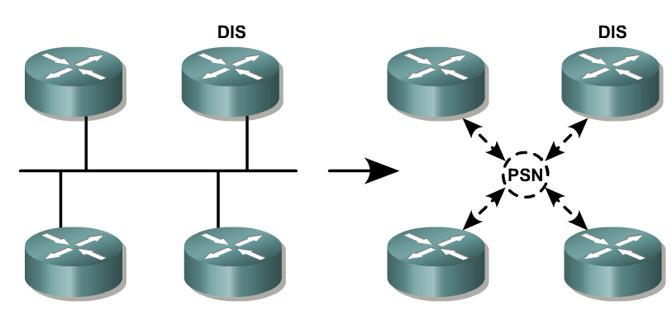
LAN Representation and Adjacencies
DIS
Similar to the DR in OSPF…
DIS (Designated IS) is elected to generate the LSP (Link State Packet, ie. LSA) representing the virtual router connecting all attached routers to a star-shaped topology
LAN uses a virtual node called pseudo node.
Represents the LAN
Sent by the DIS
Notes:
Similar to the DR in OSPF…
DIS (Designated IS) is elected to generate the LSP (Link State Packet, ie. LSA) representing the virtual router connecting all attached routers to a star-shaped topology
For SPF, the whole network must look like a collection of nodes and point-to-point links
Multi-access networks are different
LAN uses a virtual node called pseudonode.
Represents the LAN
Sent by the DIS

Slide 32
LAN Representation and Adjacencies
DIS
Election of DIS:
Router with highest priority (in the range of 0-127, Cisco default is 64)
Router with highest MAC address
No Backup DIS
No way to make a router ineligible from being DIS (no OSPF priority 0)
New router (IS) can cause a new election, unlike OSPF
Periodically broadcasts CSNPs (OSPF DBD) every 10 seconds
Elect both L1 and L2 DISs
Notes:
Election of DIS:
Router with highest priority (Cisco default is 64)
Router with highest MAC address
No “BDR”
No way to make a router ineligible from being DIS (no OSPF priority 0)
New router (IS) can cause a new election, unlike OSPF
Periodically broadcasts CSNPs (OSPF DBD) every 10 seconds
Frame Relay: DIS is highest local DLCI if priorities are equal

Slide 33
Configuring IS-IS (so far)
DIS
Area 49.0001
SanJose1
interface FastEthernet0/0
ip address 172.16.0.1 255.255.255.0
ip router isis
isis priority 100
router isis
net 49.0001.1111.1111.1111.00
SanJose2
interface FastEthernet0/0
ip address 172.16.0.2 255.255.255.0
ip router isis
router isis
net 49.0001.2222.2222.2222.00
Area . System ID . NSEL
SanJose3
interface FastEthernet0/0
ip address 172.16.0.3 255.255.255.0
ip router isis
router isis
net 49.0001.3333.3333.3333.00
isis priority: Sets DIS priority on a LAN interface, default 64
Notes:
isis priority: Sets DIS priority on a LAN interface, default 64

Slide 34
IS-IS Routing Process
IS-IS Routing Process is divided into four stages:
Update
Decision
Forwarding
Receive
Notes:
IS-IS Routing Process is divided into four stages:
Update
Decision
Forwarding
Receive

Slide 35
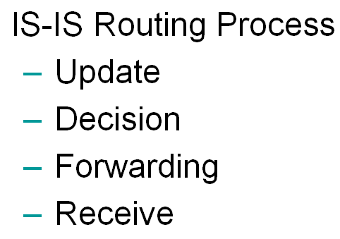
IS-IS Routing Process: Update
The Update Process
Routers can only forward data packets if they have an understanding of the network topology.
LSPs are generated and flooded throughout the network whenever:
An adjacency comes up or down (example: a new router comes online).
An interface on a router changes state or is assigned a new metric.
An IP route changes (example: because of redistribution)
Notes:
The Update Process
Routers can only forward data packets if they have an understanding of the network topology.
LSPs are generated and flooded throughout the network whenever:
An adjacency comes up or down (example: a new router comes online).
An interface on a router changes state or is assigned a new metric.
An IP route changes (example: because of redistribution)

Slide 36
IS-IS Routing Process: Update
Sending and Receiving an LSP
Receiving an LSP
If the LSP is already present in the database (LSDB), the router (IS) acknowledges (PSNP) and ignores it.
The router sends the duplicated LSP it its neighbors.
Level 1 LSPs are flooded throughout the area
Level 2 LSPs are sent across all L2 adjacencies.
Notes:
Sending and Receiving an LSP
Receiving an LSP
If the LSP is already present in the database (LSDB), the router (IS) acknowledges (PSNP) and ignores it.
The router sends the duplicated LSP it its neighbors.
Level 1 LSPs are flooded throughout the area
Level 2 LSPs are sent across all L2 adjacencies.

Slide 37
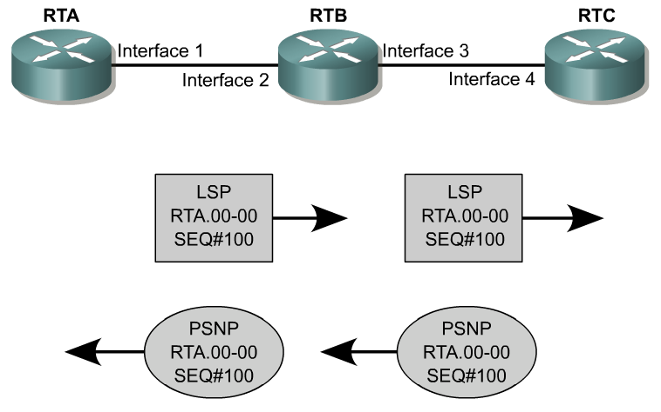
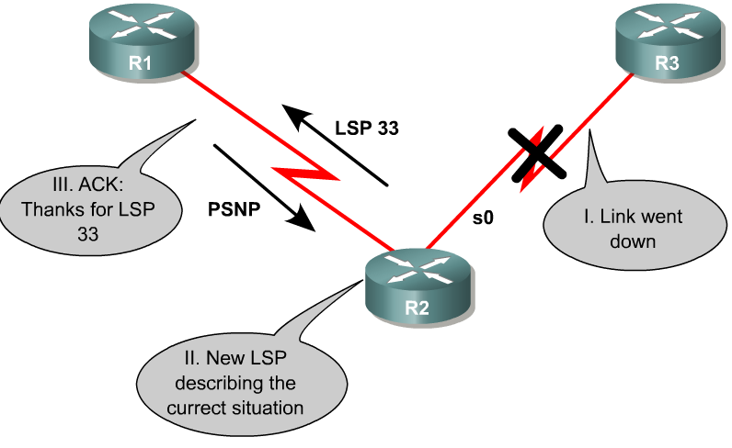
LSDB Synchronization and Update Process
LSP (LSA)
LSP (LSA)
LSP (LSA)
X
PSNP (LSAck)
PSNP (LSAck)
PSNP (LSAck)
IS-IS LSDB is accomplished by using special PDUs, known as SNPs (Sequence Number PDUs):
CSNP (Complete Sequence Number PDU) – (OSPF: DBD)
List of LSPs held by the router
PSNP (Partial Sequence Number PDU) – (OSPF: LSAck/LSR)
Acknowledge the receipt of a LSP
Request a complete LSP for a missing entry
Notes:
IS-IS LSDB is accomplished by using special PDUs, known as SNPs (Sequence Number PDUs):
CSNP (Complete Sequence Number PDU) – (OSPF: DBD)
List of LSPs held by the router
PSNP (Partial Sequence Number PDU) – (OSPF: LSAck/LSR)
Acknowledge the receipt of a LSP
Request a complete LSP for a missing entry

Slide 38
Update Process
Point-to-Point networks:
Once an LSP is sent, router sets a timer (minimumLSPTransmissionInterval) of 5 seconds
If PSNP (ACK) not received, resends LSP.
Notes:
Point-to-Point networks:
Once an LSP is sent, router sets a timer (minimumLSPTransmissionInterval) of 5 seconds
If PSNP (ACK) not received, resends LSP.

Slide 39

IS-IS Routing Process: Update
Sending and Receiving an LSP:
Propagating (sending) LSPs on a Point-to-Point Interface
When an adjacency is established both routers send a CSNP (OSPF DBD) summary of their LSDB.
If the receiving router has any LSPs that were not present in the CSNP it received, it sends a copy of the missing LSP to the other router.
CSNP
CSNP
You are missing LSP 3
LSP 3
PSNP (Ack)
Notes:
Sending and Receiving an LSP:
Propagating (sending) LSPs on a Point-to-Point Interface
When an adjacency is established both routers send a CSNP (OSPF DBD) summary of their LSDB.
If the receiving router has any LSPs that were not present in the CSNP it received, it sends a copy of the missing LSP to the other router.

Slide 40
IS-IS Routing Process: Update
Sending and Receiving an LSP:
Propagating (sending) LSPs on a Point-to-Point Interface
Likewise, if the receiving router is missing any LSPs received in the CSNP, the receiving router sends a PSNP (OSPF LSR) requesting the full LSP to be sent.
LSPs are acknowledges with a PSNP (OSPF LSAck)
When the LSP is sent, the router sets a timer.
If the acknolwedgement (PSNP) is not received within 5 seconds (Cisco default), the LSP is resent.
CSNP
CSNP
PSNP 3
LSP 3
PSNP (Ack)
I am missing LSP 3
Notes:
Sending and Receiving an LSP:
Propagating (sending) LSPs on a Point-to-Point Interface
Likewise, if the receiving router is missing any LSPs received in the CSNP, the receiving router sends a PSNP (OSPF LSR) requesting the full LSP to be sent.
LSPs are acknowledges with a PSNP (OSPF LSAck)
When the LSP is sent, the router sets a timer.
If the acknolwedgement (PSNP) is not received within 5 seconds (Cisco default), the LSP is resent.

Slide 41
IS-IS Routing Process: Update
Sending and Receiving an LSP:
Propagating (sending) LSPs on a Broadcast Interface
The DIS (OSPF DR) takes on much of the responsibility for synchronizing the databases on behalf of the pseudo node.
LSPs are not acknowledged by each receving router
DIS periodically multicast a CSNP that describes every LSP in the LSDB
DIS has three tasks:
Creating and maintaining adjacencies
Creating and updating the pseudonode LSP
Flooding the LSPs over the LAN.
Notes:
Sending and Receiving an LSP:
Propagating (sending) LSPs on a Broadcast Interface
The DIS (OSPF DR) takes on much of the responsibility for synchronizing the databases on behalf of the pseudonode.
DIS has three tasks:
Creating and maintaining adjacencies
Creating and updating the pseudonode LSP
Flooding the LSPs over the LAN.

Slide 42
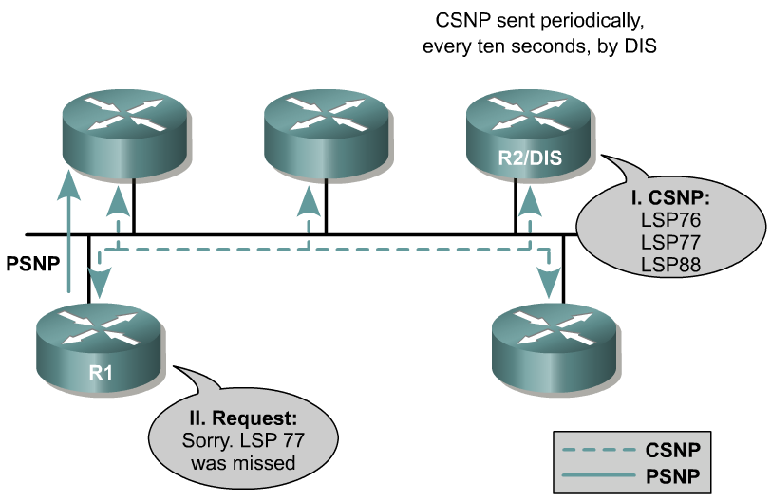
Update Process
LSP 77 (LSA)
CSNP (DBD)
PSNP (OSPF LSR) goes to DIS.
III. LSP 77 is sent by DIS to R1
PSNP (LSR)
PSNP (LSAck)
On Broadcast networks:
LSPs are not acknowledged by each receiving router.
DIS periodically multicasts a CSNP (OSPF DBD) that describes every LSP in LSDB.
Default is every10 seconds
L1 CSNPs are multicast to AllL1ISs
L2 CSNPs are multicast to AllL2ISs
Notes:
On Broadcast networks:
LSPs are not acknowledged by each receiving router.
DIS periodically multicasts a CSNP (OSPF DBD) that describes every LSP in LSDB.
Default is every10 seconds
L1 CSNPs are multicast to AllL1ISs
L2 CSNPs are multicast to AllL2ISs

Slide 43
IS-IS Routing Process: Update
Sending and Receiving an LSP:
Propagating (sending) LSPs on a Broadcast Interface
On receiving a CSNP the router compares it with its LSDB…
If the receiving router has a newer version of the LSP then what was sent in the CSNP, or if the CSNP did not contain one of its LSPs, the router multicasts the LSP to all routers on the LAN.
CSNP (DBD)
I have a newer version of LSP 88
LSP 88
Receipt of LSP 88 is acknowledged by all routers with a PSNP.
Notes:
Sending and Receiving an LSP:
Propagating (sending) LSPs on a Broadcast Interface
On receiving a CSNP the router compares it with its LSDB…
If the receiving router has a newer version of the LSP then what was sent in the CSNP, or if the CSNP did not contain one of its LSPs, the router multicasts the LSP to all routers on the LAN

Slide 44
IS-IS Routing Process: Update
Sending and Receiving an LSP:
Propagating (sending) LSPs on a Broadcast Interface
On receiving a CSNP the router compares it with its LSDB…
If the database is missing an LSP that was in the CSNP, it sends a PSNP requesting the full LSP.
The DIS sends the LSP.
LSP 77 (LSA)
CSNP (DBD)
PSNP (LSR)
PSNP (LSAck)
Notes:
Sending and Receiving an LSP:
Propagating (sending) LSPs on a Broadcast Interface
On receiving a CSNP the router compares it with its LSDB…
If the database is missing an LSP that was in the CSNP, it sends a PSNP requesting the full LSP.
The DIS sends the LSP.

Slide 45
IS-IS Routing Process: Update
Determining if an LSP is valid:
Receiving router uses three fields to help determine if the received LSP is more recent than the one in its LSDB.
Remaining Lifetime
Used to age-out or delete LSPs
Lifetime is set to 0 and flooded
Receiving routers recognize this means the route is bad and deletes the LSP from their LSDB, rerunning SPF algorithm, new SPT, new routing table.
Note: LSPs have a maximum age of 20 minutes in an IS-IS LSDB (can be increased to 65535 seconds, ~18.2 hours), and are re-flooded (refreshed) every 15 minutes.
Expired LSP will be kept in the LSDB for 60 seconds (ZeroAgeLifetime)
Sequence Number
First LSP starts with a sequence number of 1, with following LSPs incremented by 1.
When sequence number reaches maximum (0xffffffff), the IS-IS process shuts down for 21 minutes (MaxAge + ZeroAgeLifetime) to allow old LSPs to age out
Checksum
If received LSP’s checksum does not computer correctly, the LSP is flushed and the lifetime set to 0.
The receiving router floods the LSP with the lifetime set to 0.
When the originating router gets this LSP (lifetime = 0) it retransmits a new LSP.
Notes:
Determining if an LSP is valid:
Receiving router uses three fields to help determine if the received LSP is more recent than the one in its LSDB.
Remaining Lifetime
Used to age-out or delete LSPs
Lifetime is set to 0 and flooded
Receiving routers recognize this means the route is bad and deletes the LSP from their LSDB, rerunning SPF algorithm, new SPT, new routing table.
Note: LSPs have a maximum age of 20 minutes in an IS-IS LSDB, and are re-flooded (refreshed) every 15 minutes.
Sequence Number
First LSP starts with a sequence number of 1, with following LSPs incremented by 1.
Checksum
If received LSP’s checksum does not computer correctly, the LSP is flushed and the lifetime set to 0.
The receiving router floods the LSP with the lifetime set to 0.
When the originating router gets this LSP (lifetime = 0) it retransmits a new LSP.

Slide 46
IS-IS Routing Process: Decision
IS-IS Routing Process is divided into four stages:
Update
Decision
Forwarding
Receive
Notes:
IS-IS Routing Process is divided into four stages:
Update
Decision
Forwarding
Receive

Slide 47
IS-IS Routing Process: Decision
The Decision Process
Uses Dijkstra’s algorithm to build a SPT (Shortest Path Tree)
The SPT is used to create the forwarding table, also known as the routing table.
Several tables are used during this process:
PATH table
PATH table is the SPT during the construction of the LSDB
Each candidate route is placed in the PATH table while the metric is examined to determine if it is the shortest path to the destination.
TENT is the tentative database (a scratchpad) during this process
Notes:
The Decision Process
Uses Dijkstra’s algorithm to build a SPT (Shortest Path Tree)
The SPT is used to create the forwarding table, also known as the routing table.
Several tables are used during this process:
PATH table
PATH table is the SPT during the construction of the LSDB
Each candidate route is placed in the PATH table while the metric is examined to determine if it is the shortest path to the destination.
TENT is the tentative database (a scratchpad) during this process

Slide 48
IS-IS Metrics
Specified in ISO 10589
Default – Must be supported
Delay – Optional. Reflect the transit delay of a subnetwork
Expense – Optional. Reflect the monetary cost of using the subnetwork
Error – Optional. Reflect the residual error probability of the subnetwork.
Cisco only supports the default metric

Slide 49
IS-IS Routing Process: Decision
Determining the best route
Criteria by which the lowest cost paths are selected and placed in the forwarding database are:
Internal paths are chosen before external paths outside the routing domain, to prevent sub-optimal routes and routing loops.
Level 1 paths within the area are “more attractive” than Level 2 paths outside the area, to prevent sub-optimal routes and routing loops.
If there is no path, the forwarding database sends the packet to the nearest Level 2 router, which is the default router.
Notes:
Determining the best route
Criteria by which the lowest cost paths are selected and placed in the forwarding database are:
Cisco allows up to six equal-cost paths, four by default.
Cisco only supports the default metric
Internal paths are chosen before external paths outside the routing domain, to prevent sub-optimal routes and routing loops.
Level 1 paths within the area are “more attractive” than Level 2 paths outside the area, to prevent sub-optimal routes and routing loops.
Longest match or most specific address in IP ensures that the closest router is chosen.
ToS (Type of Service) in IP header is used, if configured.
If there is no path, the forwarding database sends the packet to the nearest Level 2 router, which is the default router.

Slide 50
IS-IS Routing Process: Forwarding
IS-IS Routing Process is divided into four stages:
Update
Decision
Forwarding
Receive
Notes:
IS-IS Routing Process is divided into four stages:
Update
Decision
Forwarding
Receive

Slide 51
IS-IS Routing Process: Forwarding and Receiving
Forwarding process
After the SPT has been built the forwarding database can be created.
The forwarding table is the lookup table for the longest match.
Receive process
If the frame is valid, the receive process passes user data and error reports to the forwarding process.
Whereas routing information: Hellos, LSPs, and SNPs are sent to the update process.

Slide 52
Odds and Ends
L1L2 routers run two IS-IS processes, one for its L1 LSDB and another for its L2 LSDB.

Slide 53
IS-IS Packet Format
MAC Hdr
IS-IS Hdr
IS-IS type-specific Data
MAC Header
Src – MAC addr of sending interface
Dst – 01-80-C2-00-00-14 for Level-1 ISs
01-80-C2-00-00-15 for Level-2 ISs
IEEE 802.2 LLC Frame format
IS-IS Header
Intra-domain Routing Protocol Discriminator: 0x83
Length – length of the header in bytes
Version/Protocol ID: 1
ID Length: length of the system ID
PDU Type
Version: always set to 1
Max Area Addresses: # of area addresses permitted for this IS Area
Notes:
01:00:5E:00:00:00 - 01:00:5E:7F:FF:FF 0x0800 IPv4 Multicast (RFC 1112), insert the low 23 Bits of the multicast IPv4 Address into the Ethernet Address (RFC 7042 2.1.1.)
33:33:xx:xx:xx:xx 0x86DD IPv6 Multicast (RFC 2464), insert the low 32 Bits of the multicast IPv6 Address into the Ethernet Address (RFC 7042 2.3.1.)
224.0.0.5 The Open Shortest Path First (OSPF) All OSPF Routers address is used to send Hello packets to all OSPF routers on a network segment.
224.0.0.6 The OSPF All Designated Routers ""(DR)"" address is used to send OSPF routin`g information to designated routers on a network segment.

Slide 54
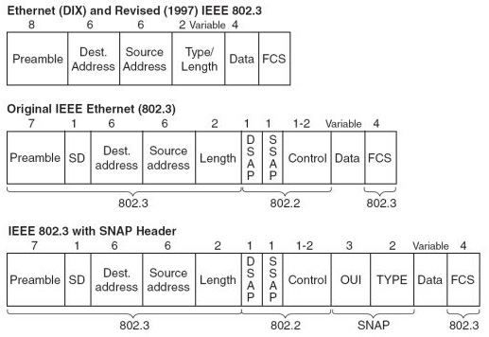
0xFE
0xFE
0X03
0xFE -- ISO Network Layer Protocol

Slide 55
IS-IS Header Format
Intradomain Routing Proto Discrminator
0X83
Length
1
Version/Protocol ID
ID Length
1-8, 255: Null System ID
Rsvd
PDU Type
Version
1
Reserved
Max Area Addresses
Length – the length of the fixed header in octets
ID Length – the length of the System ID field. 0: 6 octets, 255: zero octet
Max Area addresses – the number of area address permitted for this IS area. In the range of 1-254, 0: 3 addresses

Slide 56
IS-IS PDU Types
IS-IS PDU Type | Value
Hello PDUs
Level 1 LAN Hellos | 15
Level 2 LAN Hello | 16
Point-to-point Hello | 17
Link State PDUs
Level 1 LSP | 18
Level 2 LSP | 20
Sequence Number PDUs
Level 1 CSNP | 24
Level 2 CSNP | 25
Level 1 PSNP | 26
Level 2 PSNP | 27

Slide 57
Terminology
CLV (Code/Length/Value) and TLV (Type/Length/Value)
Same thing, CLV is more of the OSI term.
There are variable length fields in a PDU.
Code or Type specifies the type of information.
Length specifies the size of the Value field.
Value is the information itself.
Example CLV or TLV 128 defines the capability to carry IP routes in IS-IS packets, in essence TLV 128 is Integrated IS-IS.
Notes:
CLV (Code/Length/Value) and TLV (Type/Length/Value)
Same thing, CLV is more of the OSI term.
There are variable length fields in a PDU.
Code or Type specifies the type of information.
Length specifies the size of the Value field.
Value is the information itself.
Example CLV or TLV 128 defines the capability to carry IP routes in IS-IS packets, in essence TLV 128 is Integrated IS-IS.

Slide 58
IS-IS TLV Codes – Specified in ISO 10589
Type | TLV | Description
1 | Area Addresses | Area address of the originating IS
2 | IS Neighbors | List the originator’s IS-IS neighbors and the metrics
3 | ES Neighbors | Not relevant to IP routing
4 | Partition Designated Level 2 IS | Not supported
5 | Prefix Neighbors | Reachable address prefix neighbors
6 | IS Neighbors (Hellos) | System IDs of all neighbors whose Hellos have been heard within the last Hold time.
8 | Padding | Pad a Hello PDU to minimum 1492 bytes or the MTU
9 | LSP Entries | Summarize LSPs
10 | Authentication Information | Authentication type and information
14 | LSP Buffer size | The LSP buffer size of the originator
Type
Length
Value
1 byte
1 byte
length

Slide 59
IS-IS TLV Codes – Specified in RFC 1195
Type | TLV | Description
128 | IP Internal Reachability Information | List IP addr/mask within the routing domain
129 | Protocols Supported | Protocols supported by the originator (v4, v6…)
130 | IP External Reachability Information | List IP addr/mask external to the routing domain
131 | Inter-Domain Routing Protocol Information | Carry information from external routing protocols transparently through the IS-IS domain
132 | IP Interface Address | IP address of the interface out which the PDU was sent
133 | Authentication Information | Authentication type and information
Type
Length
Value
1 byte
1 byte
length

Slide 60
IS-IS TLV used in each PDU
Type | TLV | 15 | 16 | 17 | 18 | 20 | 24 | 25 | 26 | 27
 |  | Hello |  |  | LSP |  | Sequence #
1 | Area Addresses | X | X | X | X | X
2 | IS Neighbors |  |  |  | X | X
3 | ES Neighbors |  |  |  | X
4 | Partition Designated Level 2 IS |  |  |  |  | X
5 | Prefix Neighbors |  |  |  |  | X
6 | IS Neighbors (Hellos) | X | X
8 | Padding | X | X | X
9 | LSP Entries |  |  |  |  |  | X | X | X | X
10 | Authentication Information | X | X | X | X | X | X | X | X | X
128 | IP Internal Reachability Information |  |  |  | X | X
129 | Protocols Supported | X | X | X | X | X
130 | IP External Reachability Information |  |  |  | X | X
131 | Inter-Domain Routing Protocol Information |  |  |  |  | X
132 | IP Interface Address | X | X | X | X | X

Slide 61
IS-IS TLV Codes – Extending Capabilities
Type | TLV | RFC | Description
12 | Optional Checksum | 3358 | Add checksum capability to SNPs
22 | Extended IS Reachability | 3784 | Add traffic engineering capabilities, replace type 2 TLV
134 | Traffic Engineering Router ID | 3784 | traffic engineering capabilities
135 | Extended IP Reachability | 3784 | traffic engineering capabilities, replace type 128 and 130 TLVs
137 | Dynamic Hostname | 2763 | Identified by hostname instead system ID
211 | Restart | 3847 | Graceful Restart
222 | MT Intermediate Systems | Draft | Multi-topology support
229 | Multi-Topology | Draft | Multi-topology support
232 | IPv6 Internet Address | Draft | Type 132 TLV equivalent
235 | MT Reachable IPv4 Prefixes | Draft | Multi-topology support
236 | IPv6 Reachability | Draft | Type 128, 130 TLV equivalent
237 | MT Reachable IPv6 Prefixes | Draft | Multi-topology support
240 | Point-to-point Three-way Adjacency | 3373
250 | Experimental | Draft

Slide 62
IS-IS Hello PDU Format
Intra-domain Routing Proto Discriminator
1
Length
1
Version/Protocol ID
1
ID Length
1
Rsvd
PDU Type
1
Version
1
Reserved
1
Max Area Addresses
1
Rsvd
Circuit Type
1
Source ID
ID Length
Holding Time
2
PDU Length
2
Rsvd
Priority
2
LAN ID
ID Length + 1

Slide 63
Hello PDU Fields
Source ID – System ID of the router that originated the Hello
Holding Time – time should wait before declaring the originating router dead
PDU length – Length of the entire PDU
Priority – Used for electing DR. Range 0 – 127 with higher number means higher priority
LAN ID – System ID of the DR plus one more octet (the pseudo node ID)

Slide 64
IS-IS Hello PDU Format – Point-to-point
Intra-domain Routing Proto Discriminator
1
Length
1
Version/Protocol ID
1
ID Length
1
Rsvd
PDU Type
1
Version
1
Reserved
1
Max Area Addresses
1
Rsvd
Circuit Type
1
Source ID
ID Length
Holding Time
2
PDU Length
2
Local Circuit ID
1
Local Circuit ID – Assigned by the originating router and is unique among the router’s interfaces

Slide 65
IS-IS LSP PDU Format
Intra-domain Routing Proto Discriminator
1
Length
1
Version/Protocol ID
1
ID Length
1
Rsvd
PDU Type
1
Version
1
Reserved
1
Max Area Addresses
1
PDU Length
2
Remaining Life Time
2
LSP ID
ID Length + 2
Sequence number
4
Checksum
2
P
ATT
OL
IS Type
1
Notes:
P – Partition bit : Partition repair capability. Not supported.
ATT – Attached bit : Used by L2 and L1/L2 routers to indicate they have route to another area.
OL – Overload bit : the originating router is experiencing a memory overload and has incomplete Link-State Database. Other routers still route packets to the overloaded router’s directly connected networks, but do not use the router for transit traffic.
LSP ID – the system ID, the pseudo node ID and the LSP number of the LSP

Slide 66
IS-IS CSNP Format
Intra-domain Routing Proto Discriminator
1
Length
1
Version/Protocol ID
1
ID Length
1
Rsvd
PDU Type
1
Version
1
Reserved
1
Max Area Addresses
1
PDU Length
2
Source ID
ID Length + 1
Start LSP ID
ID Length + 2
End LSP ID
ID Length + 2

Slide 67
IS-IS PSNP Format
Intra-domain Routing Proto Discriminator
1
Length
1
Version/Protocol ID
1
ID Length
1
Rsvd
PDU Type
1
Version
1
Reserved
1
Max Area Addresses
1
PDU Length
2
Source ID
ID Length + 1

